Slide 1
MP4GS – SVS Johnny Haddock
Mobile Platform for Graduate Students – Stereoscopic Vision System
Spring 2017
Notes:
Introduction of Self
Introduction of MP4GS (pre-built platform for use by Grad school for more in-depth study of topic of interest)
Focus on Stereoscopic Vision demonstration of the capabilities

Slide 2
Notes:
8-bit 16MHz
54 Digital I/O (15 PWM)
16 Analog inputs
4 Hardware UARTs
256KB Memory
Bluetooth 2.1 EDR
12v 2.8A dual H-bridge motors 1deg resolution /100mm wheel
4 joint robotic arm
Ultrasonic range sensor
uCam cameras (80x20 2-bit grey – 640-480 JPEG)

Slide 3
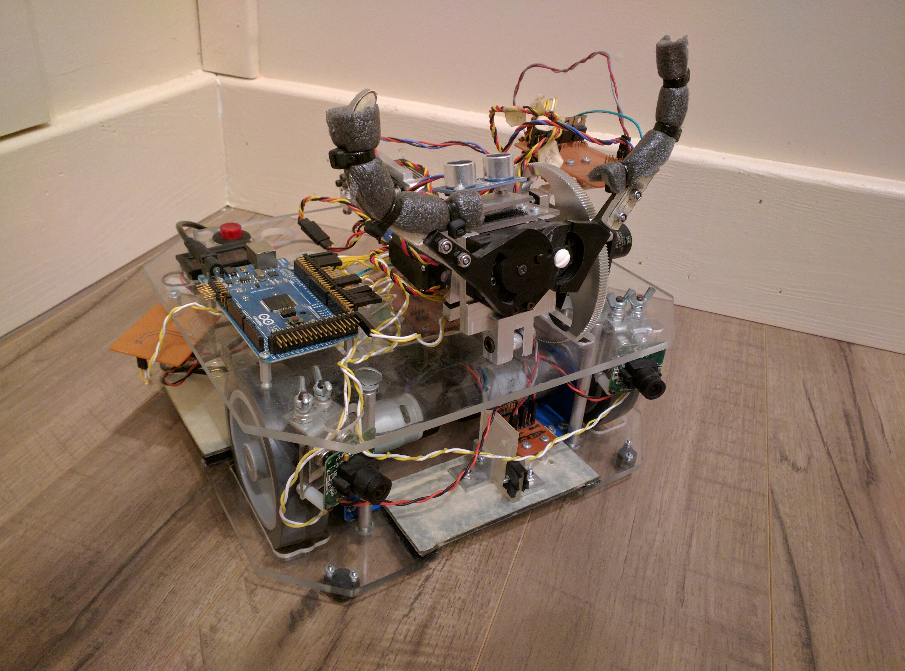
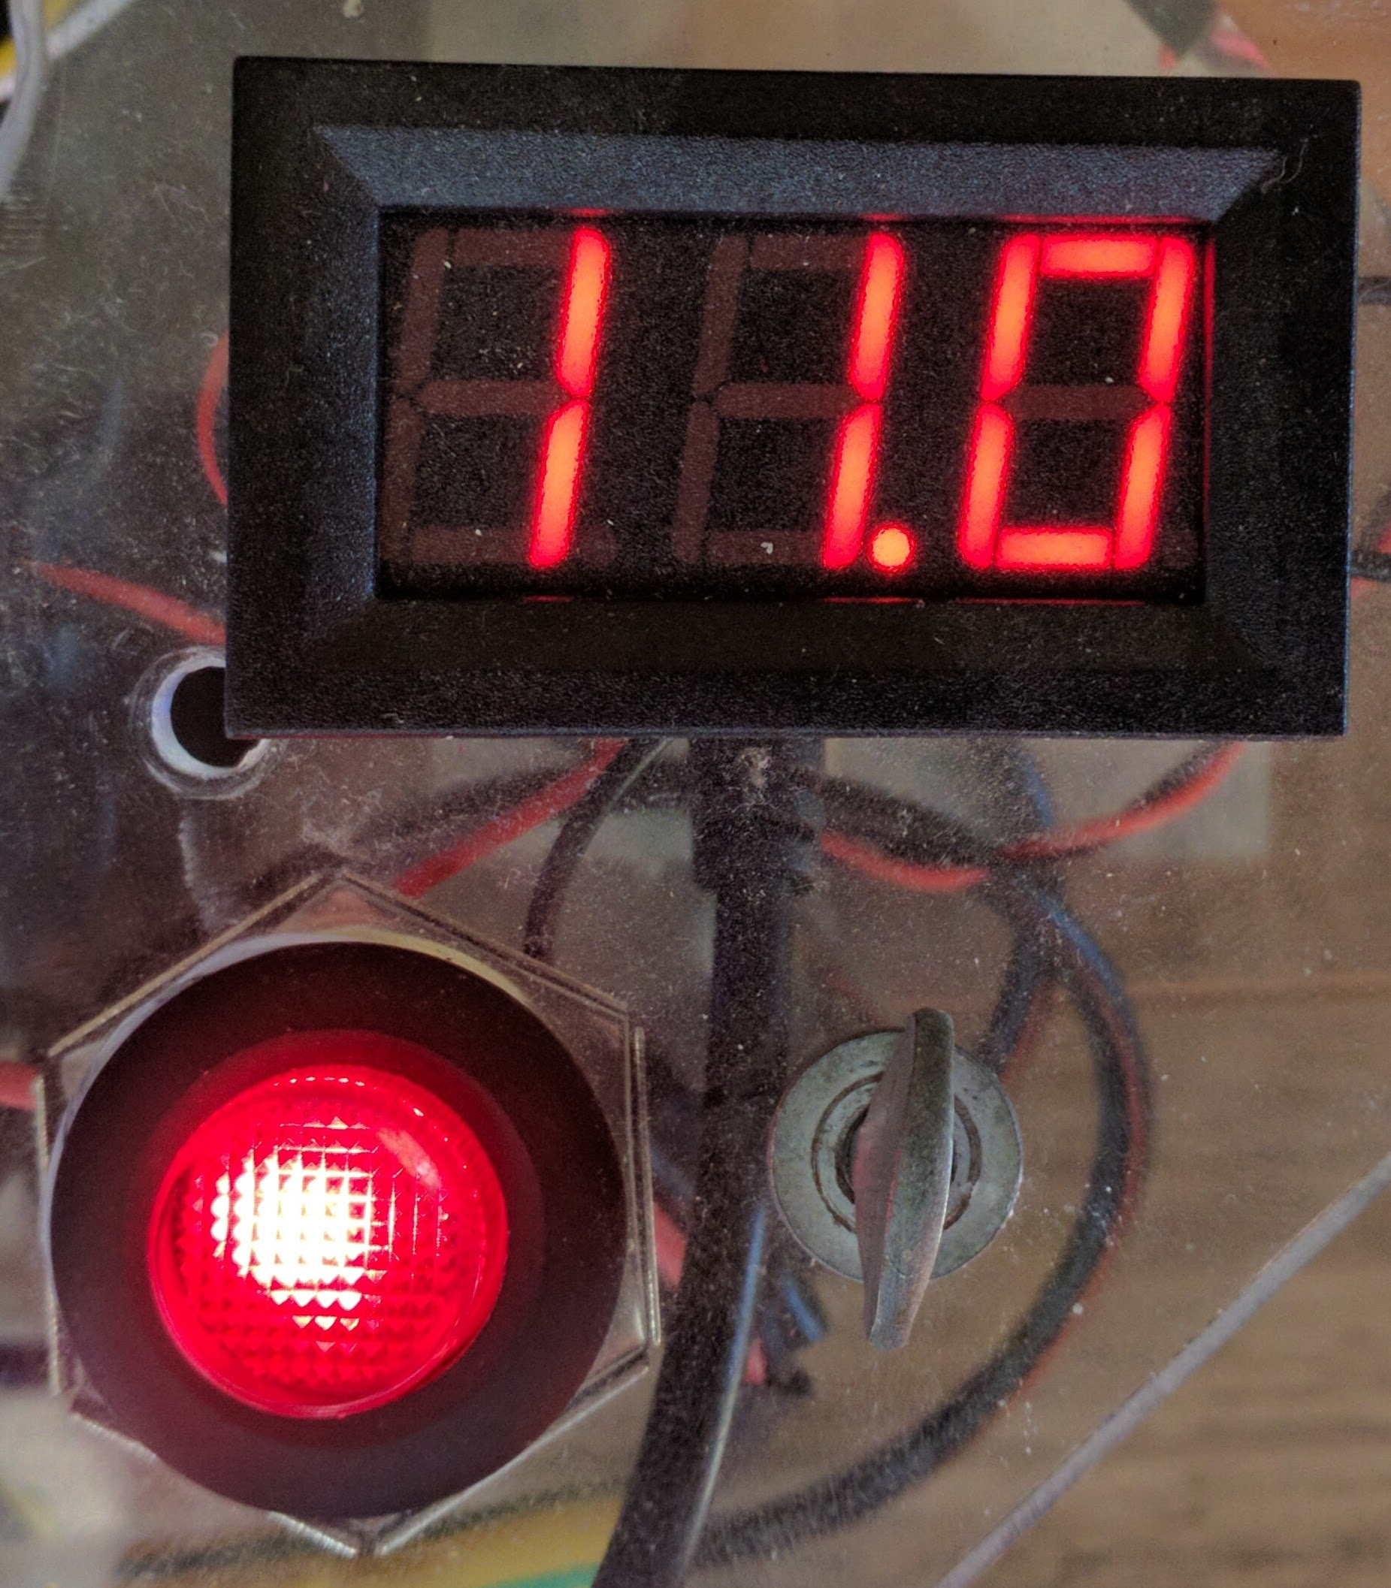
Notes:
3 interchangeable sensor areas, attached with Velcro
PDU (12V raw battery, 8V, 7V, 6V, 5V, 3.3V)
Battery gauge

Slide 4
Video of MP4GS

Slide 5
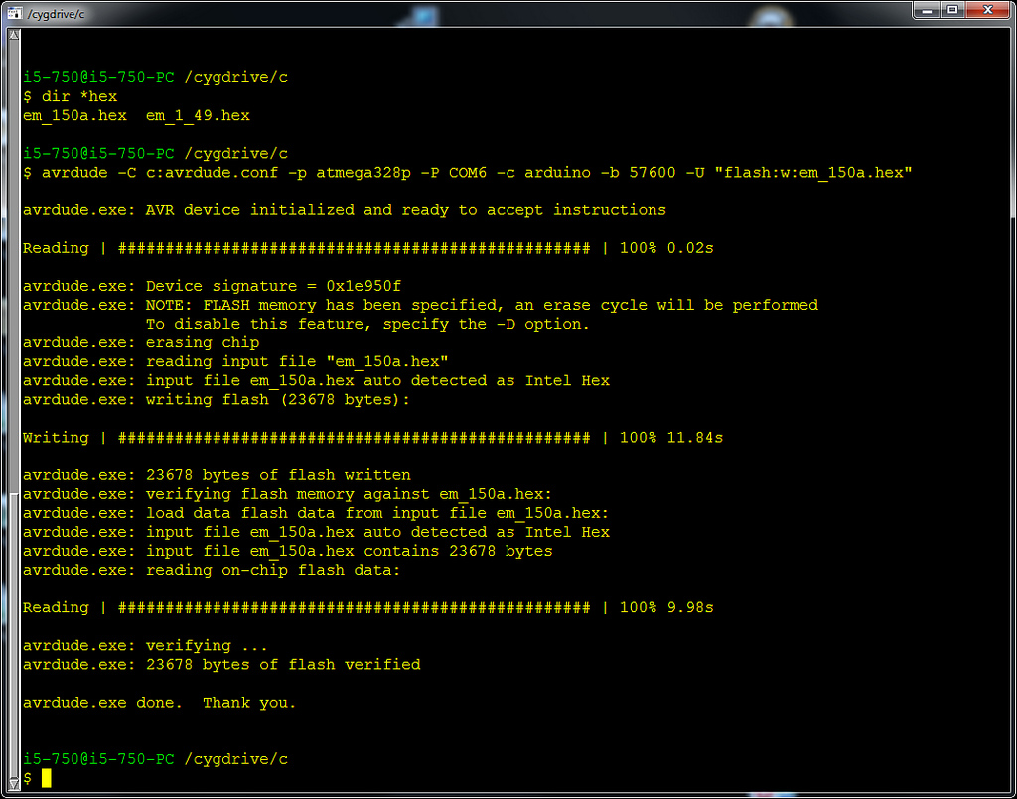
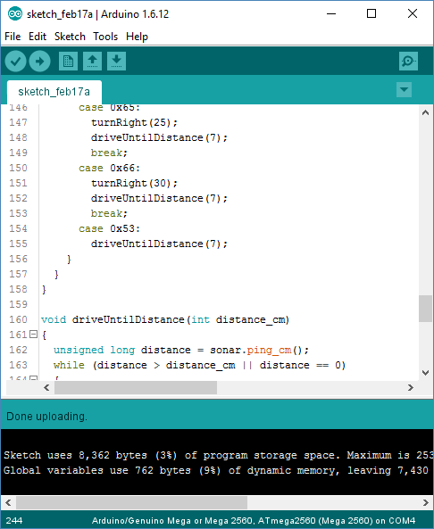
Notes:
Can be programed in ASM, C, or C++ with gcc bindings for cross platform building. Support for Windows, OSX, Linux, and FreeBSD
For advanced projects Eclipse can be used

Slide 6
SVS
Optics and stereoscopic vision
Notes:
Have the audience do the stereopsis experiment (hold hand in front of hand and alternate closing eye)

Slide 7
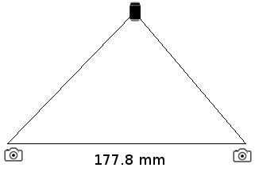
Notes:
Layout of MP4GS

Slide 8
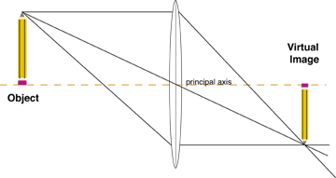
Notes:
Problems of real lens camera

Slide 9
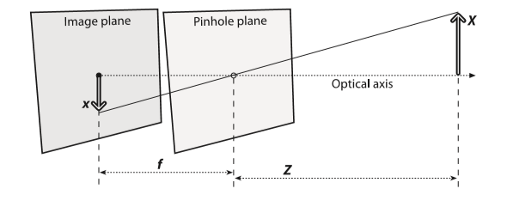
Notes:
Pinhole camera work differently

Slide 10
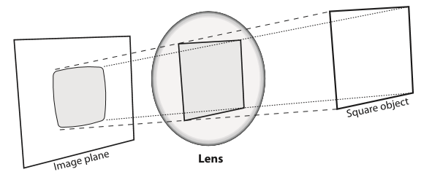
Lens Distortion
Notes:
Lens Distortion

Slide 11
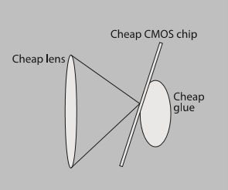
Intrinsic and Distortion Sources
Notes:
Intrinsic Camera Distortion
The Intrinsic matrix is the focal length along the x and y axis [[f_x, 0, c_x][0,f_y,c_y][0,0,1]] (c is the principle point (actual center of lens))

Slide 12
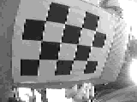
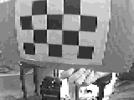
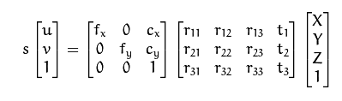
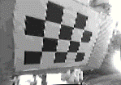
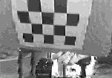
Raw Image
Raw Image
Undistorted
Undistorted
Notes:
Images once corrected for imperfections. These now are pinhole cameras

Slide 13
Bimodal Transform
Median Blur
Notes:
Image detection is done with simple bimodal transforms and noise reduction

Slide 14
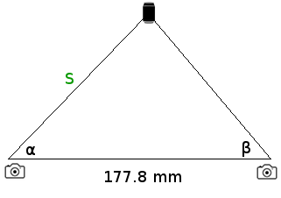
Notes:
Use Law of Sines to find “S”
S = (177.8 * math.sin(beta)) / (math.sin(math.pi - beta-alpha))

Slide 15
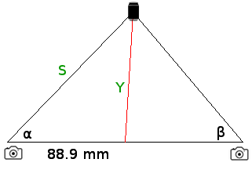
Notes:
Use Law of Cosines to find “Y”
Y = math.sqrt(7903.21 + (S*S) - (177.8 * S * math.cos(alpha)))

Slide 16
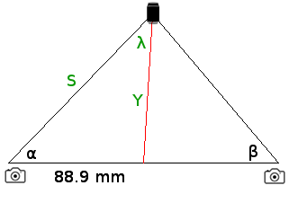
Notes:
Use Law of Cosines to find “Lambda”
Lambda = math.asin(88.9*math.sin(alpha)/Y)
NOTE: Lambda must be < 90 or the asin function will return an incorrect value, this is true as long as the object is >~5 inches away

Slide 17
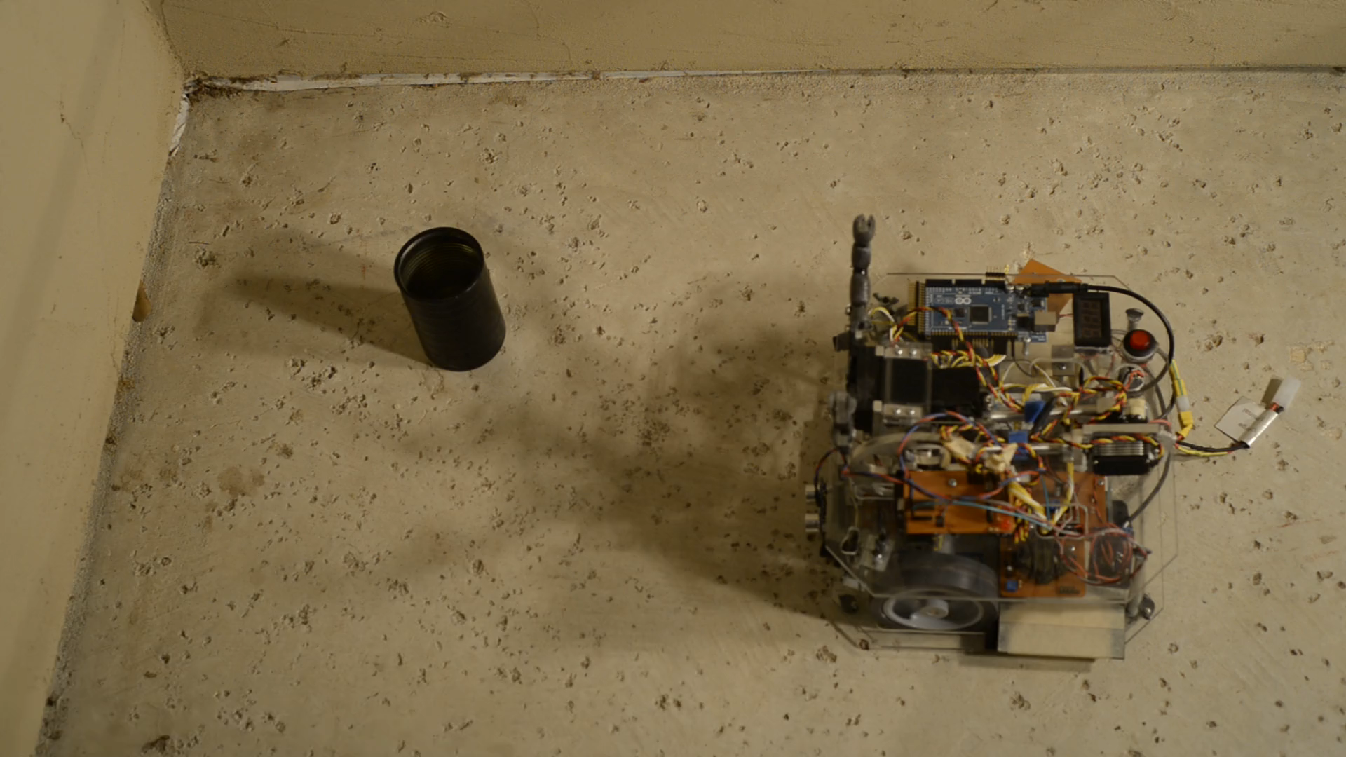

Slide 18
Questions?
Thank you

